Slide 1

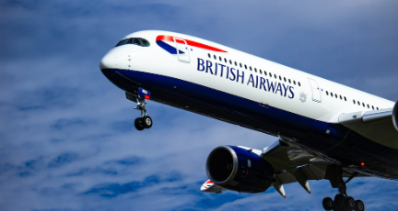
British Airway
Customer Review

Slide 2
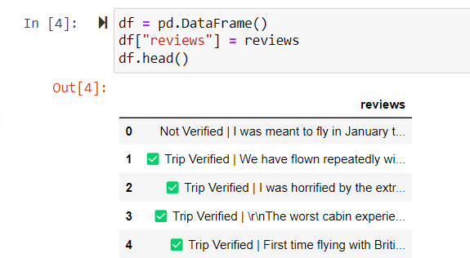
Web scarpping
Scrap the data from the website called Skytrax
Used library such as request,Beautifulsoup
for it.

Slide 3
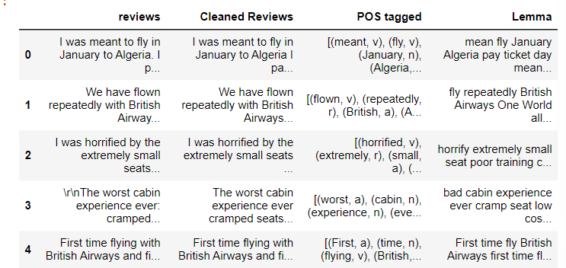
Data preprocessing
Using library such as nltk used for natural processing (nlp) tasks such as
tokenization,stemming,tagging,parsing and more
Obtaining the stem words – Lemmatization

Slide 4
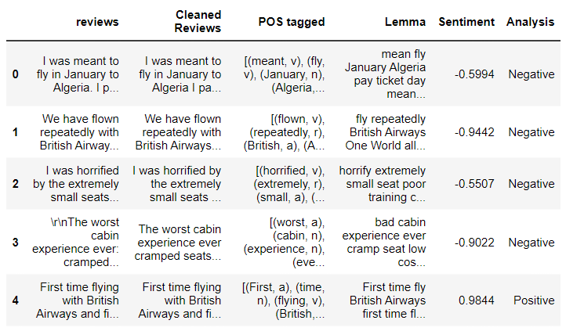
Sentiment Analysis using VADER.
VADER (Valence Aware Dictionary and Sentiment Reasoner).
Vader sentiment not only tells if the statement is positive or negative along with the intensity of emotion

Slide 5
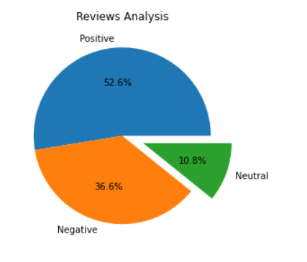
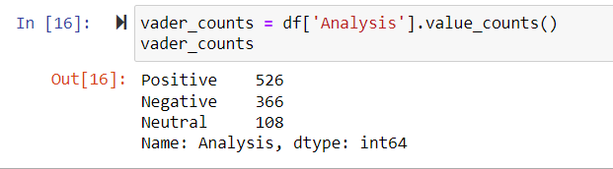
ANALYSIS COUNTS & VISUAL REPRESENTATION

Slide 6
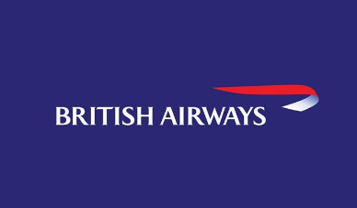

BRITISH AIRWAYS
Predict customer buying behavior

Slide 7
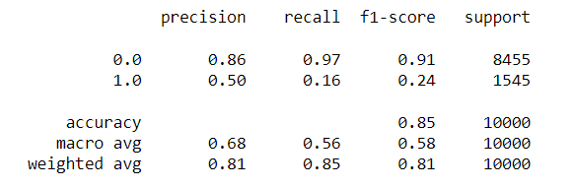
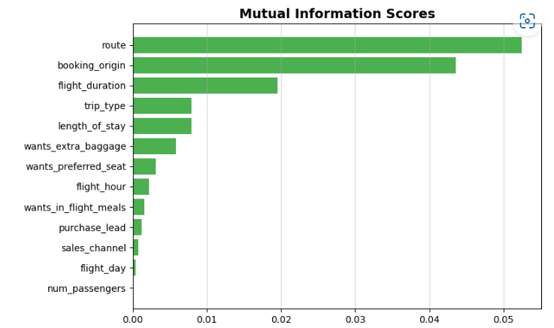
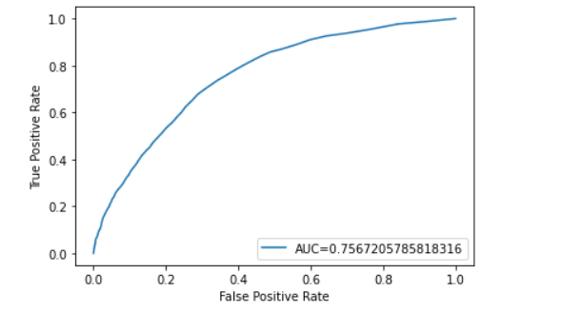
Train the Data set with Random Forest Classifier Model
Accuracy Score= 0.85

